Slide 1
Falls Prevention
Part 1

Slide 2
Starter Activity
Complete the “Keeping your home safe” quiz on the first page of your Falls Prevention, Part 1 - Workshop Guide
We will return to this quiz throughout the workshop

Slide 3
Agenda
Preventing a Fall Before it Happens
Postural Hypotension
Additional Strategies to Avoid Falls

Slide 4
Learning Objectives
I will be able to…
Identify 5 potential hazards that might increase my risk of falling and be able to identify one method for preventing each potential hazard
Briefly describe postural hypotension including its potential symptoms
Identify a minimum of three methods for managing low blood pressure
Identify a minimum of five potential strategies for preventing falls within the home

Slide 5
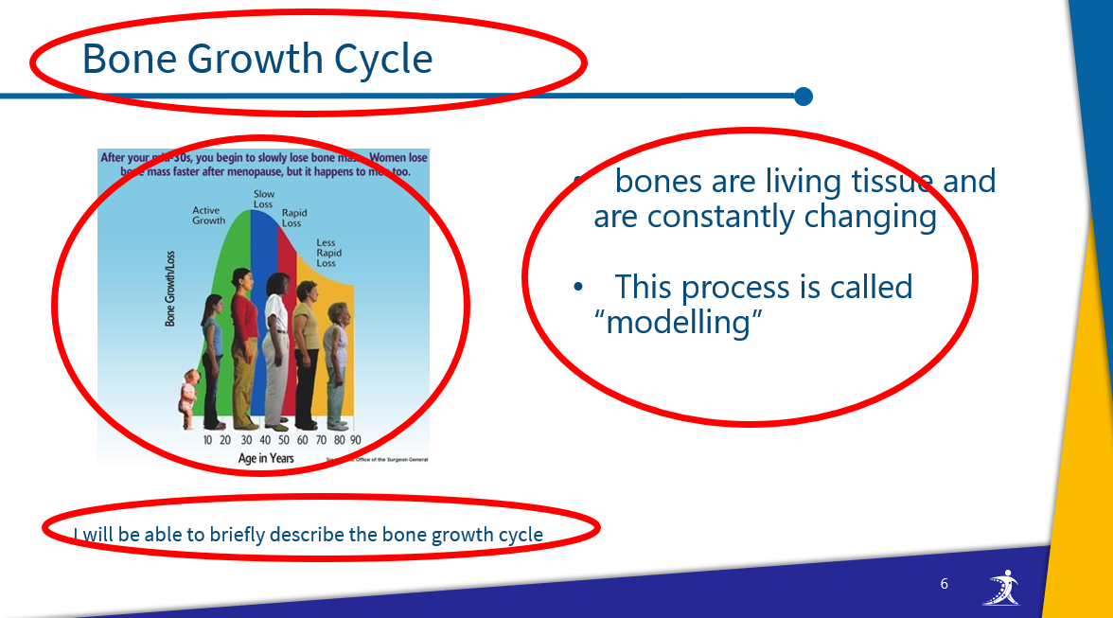
How to navigate the slides
slide title
slide image
key information
learning objective

Slide 6
Workshop Guide
As we progress through this workshop, please ensure to complete the appropriate sections of the Workshop Guide provided for you.
This will be your quick reference following this workshop to aid you on your bone health journey.

Slide 7
Preventing a Fall Before it Happens

Slide 8
Keeping Your Home Safe
Review your “Keeping your home safe” quiz on the first page of your Falls Prevention, Part 1 - Workshop Guide
Go through each section and identify any “No” responses
  Are there any patterns that you notice?
  What are the major problem areas identified by your quiz?
I will be able to Identify 5 potential hazards that might increase the risk of falling and be able to identify one method for preventing each potential hazard.

Slide 9

In your groups, share your major problem areas or patterns and identify any common areas shared by everyone or most of the group
Select one question per heading and, as a group, come up with a solution to each problem that you can all implement to help prevent a potential fall
You will have 15 minutes
Record your ideas in your
Falls Prevention, Part 1 - Workshop Guide
I will be able to Identify 5 potential hazards that might increase the risk of falling and be able to identify one method for preventing each potential hazard.

Slide 10
Postural Hypotension

Slide 11
What is Postural Hypotension?
Postural Hypotension occurs when there is a drop in your blood pressure when you stand up from sitting or lying down
  it can happen when you get up from a chair or when you are standing
Symptoms
  feeling dizzy
  feeling light-headed
  blurred vision
  passing out
This sudden change in blood pressure can lead to a fall
I will be able to briefly describe postural hypotension including its potential symptoms.

Slide 12
Managing Low Blood Pressure
With the person beside you, discuss the following question:
What can you do to manage low blood pressure?
I will be able to identify a minimum of three methods for managing low blood pressure.

Slide 13
Managing Low Blood Pressure
Things you can do to help manage low blood pressure:
After lying in a bed or sitting in a chair, change your position slowly
Avoid alcohol and heat (hot showers, baths and weather)
If you feel dizzy, sit down or lie down immediately
  When the feeling goes away, get up slowly
I will be able to identify a minimum of three methods for managing low blood pressure.

Slide 14
Managing Low Blood Pressure
Things you can do to help manage low blood pressure:
Eat 5-6 small meals each day, rather than 2-3 larger meals
Discuss with your physician if you are drinking enough fluids
  Too little water can lower your blood pressure.
I will be able to identify a minimum of three methods for managing low blood pressure.

Slide 15
Managing Low Blood Pressure
Things you can do to help manage low blood pressure:
Before you sit or stand up
  squeeze and relax the muscles in your legs
  squeeze and relax your entire body
  bend forward with your arms crossed over your belly
  squeeze and relax your fists as you squeeze and relax the muscles in your arms
  squat
I will be able to identify a minimum of three methods for managing low blood pressure.

Slide 16
Managing Low Blood Pressure
Things you can do to help manage low blood pressure:
Wear support stocking and/or abdominal binder
  talk to your doctor about these options
I will be able to identify a minimum of three methods for managing low blood pressure.

Slide 17
Additional Strategies to Avoid Falls

Slide 18
Exercise
Physiotherapists can assist with a falls prevention program and advise on programs run in the community
  supervised resistance training to strengthen muscles
  balance exercises, for example, heel-to-toe walking, Tai Chi
I will be able to identify a minimum of five potential strategies for preventing falls within the home.

Slide 19
Medical Review
Ask your doctor to review any conditions or medications that may be causing your poor balance or dizziness
Your doctor may recommend a visit to an optometrist to correct your vision and/or a podiatrist for proper footwear
Ensure to maintain a regular dialogue with your doctor, including regularly reviewing your medication
I will be able to identify a minimum of five potential strategies for preventing falls within the home.

Slide 20
Nutrition
Speak to your doctor about how you can improve your nutrition, including how to you ensure adequate calcium and vitamin D levels
Eat regular meals and snacks throughout the day
  it is better to eat 5-6 smaller meals than 2-3 large meals
I will be able to identify a minimum of five potential strategies for preventing falls within the home.

Slide 21
Around the Home
Occupational Therapists can conduct a home audit and suggest important changes to the home environment or recommend walking aids if needed
Use a “home checklist”
  much like the checklist used in this workshop
I will be able to identify a minimum of five potential strategies for preventing falls within the home.

Slide 22
Cool-down Activity
Review your “Keeping your home safe” quiz from the starter activity and the solution you came up with as a group to correct any problem areas in your Falls Prevention, Part 1 - Workshop Guide
Create an action plan where you indicate 3 changes that you can implement in the next day, in the next week and in the next month, that will help you prevent a fall before it happens
I will be able to identify a minimum of five potential strategies for preventing falls within the home.

Slide 23
Additional Resources
Osteoporosis Canada
osteoporosis.ca
Dr. David Hanley Osteoporosis Centre
osteoporosiscalgary.com
National Osteoporosis Foundation
nof.org

Slide 24
Bibliography
Osteoporosis Australia. (2016). Exercise Consumer Guide [PDF File].
Public Health Agency of Canada. (2015). The Safe Living Guide: A guide to home safety for seniors. (pp. 9-17).
Alberta Health Services. (2015). Managing Postural Hypotension [PDF File].

